Slide 1
LEARNING HOW TO LEARN AND LEARN FAST.
Huynh Anh Tu

Slide 2
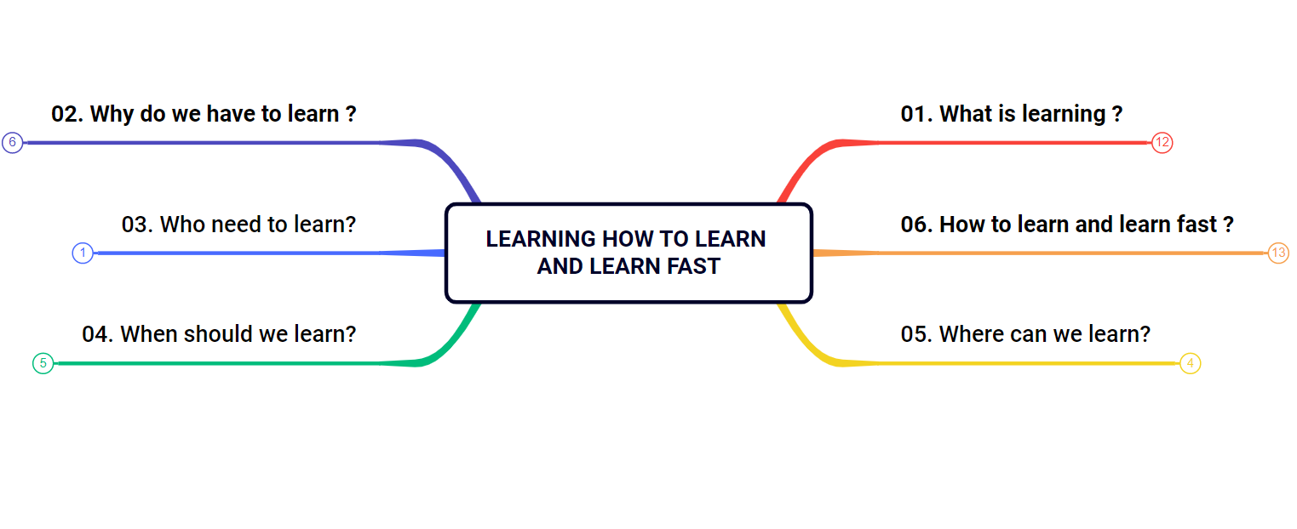

LEARNING HOW TO LEARN AND LEARN FAST

Slide 3
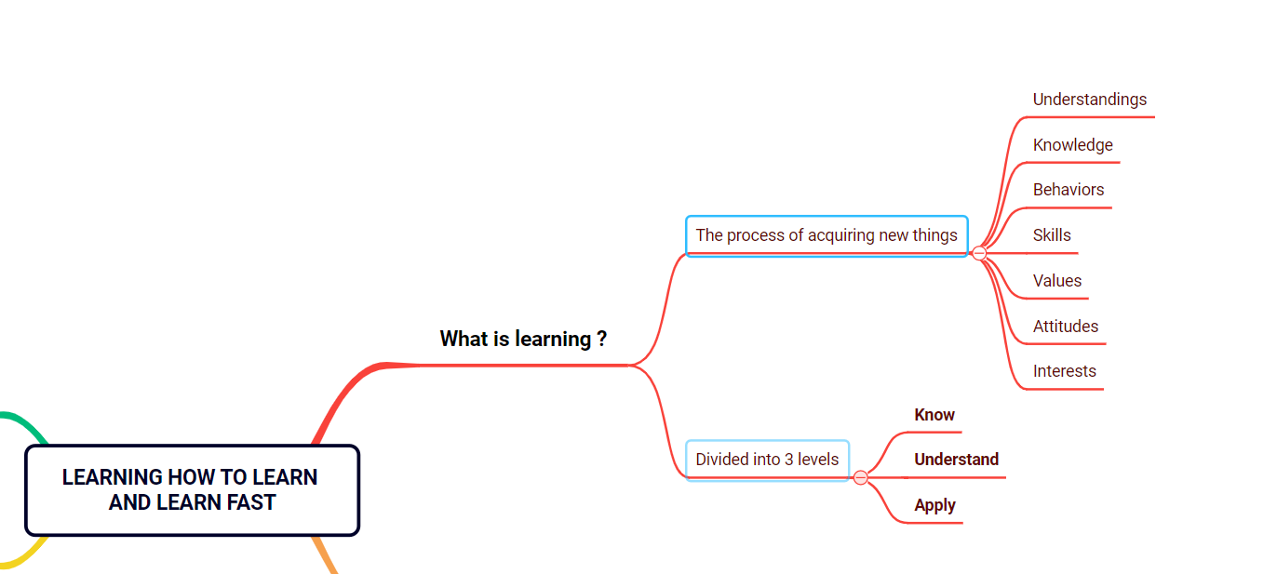
01. What is learning ?

Slide 4


01. What is learning ?
Learning is the process of acquiring new understandings, knowledge, behaviors, skills, values, attitudes or interests.
Learning is divided into 3 levels:
Know
Understand
Apply
“Know”
When we can recognize or can confirm the existence of people, things, or problems.
“Understand”
When we realize the meaning, the essence, the reasoning of something, by intellectual application
“Apply”
When we can use what we have learned, apply them in practice

Slide 5
EXAMPLE
ChatGPT is a chatbot that is driven by AI technology and allows us to converse with it like a human.
It can answer our problems or requests by taking our submission value, start processing, and return the result.
We can ask it to design a database for the sales website then edit it accordingly. This saves a lot of time when working on projects.
Know
Understand
Apply

Slide 6
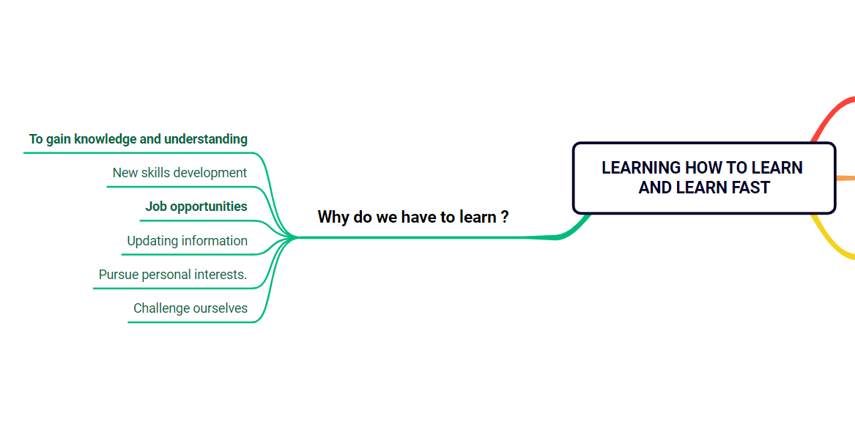
02. Why do we have to learn?

Slide 7

02. Why do we have to learn?
To gain knowledge and understanding
New skills development
Job opportunities
Updating information
Pursue personal interests.
Challenge ourselves

Slide 8

EXAMPLE
If you're a salesperson, communication skills are important for persuading customers. This skill is not available, but must go through the process of learning and training.

Slide 9
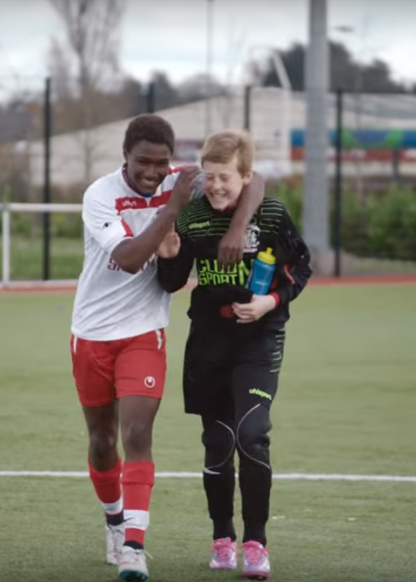
03. Who need to learn?
Learning is essential for “everyone”, regardless of profession, age, or circumstance.

Slide 10
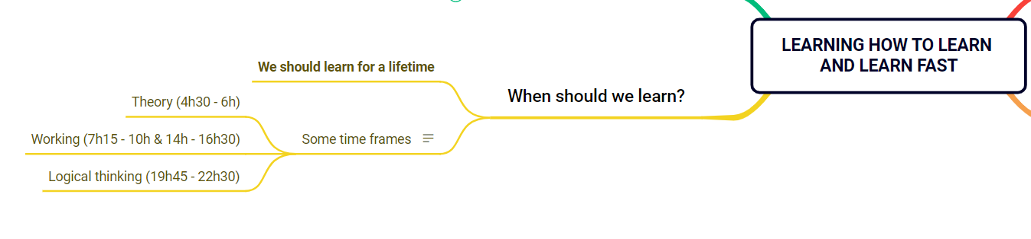
04. When should we learn?

Slide 11

04. When should we learn?
We should learn for life because learning brings so many benefits such as:
Develop knowledge and skills
Broaden horizons
Create opportunities
Improve quality of life

Slide 12

“Study, Study More, Study Forever”
- Lenin -

Slide 13
TIP
Scientifically proven, time frames make learning effective:
Study theory is from 4:30 to 6:00
Working is from 7h15 to 10h and from 14h to 16h30
Logical thinking is from 19h45 to 22h30

Slide 14
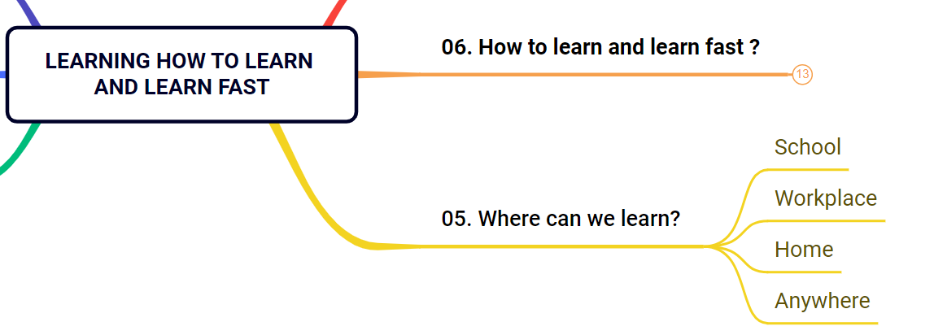
05. Where can we learn?

Slide 15

05. Where can we learn?
We can learn “anywhere”
School
Workplace
Home
. . .

Slide 16
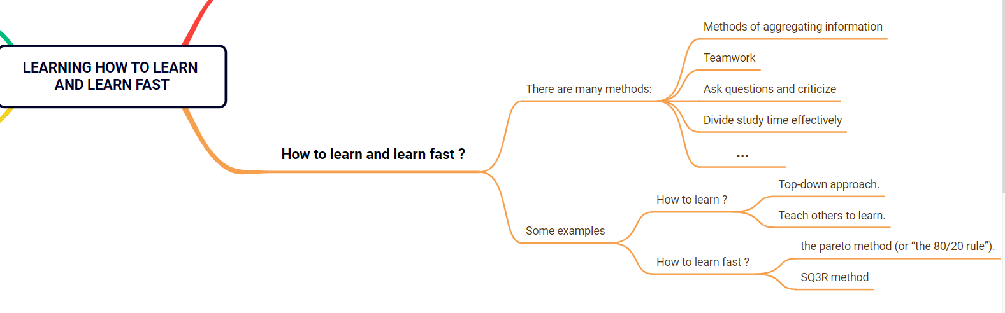
06. How to learn and learn fast ?

Slide 17

06. How to learn and learn fast ?
There are many methods to learn such as:
Methods of aggregating information
Teamwork
Ask questions and criticize
Divide study time effectively
And many other methods…
Some examples:
How to learn ?
We can use the following methods:
Top-down approach.
Teach others to learn.
How to learn fast ?
We can use the following methods:
The pareto” method (or “the 80/20 rule”).
SQ3R method.

Slide 18
Top-down approach
Big goal
“Top-down approach” is a management technique.
This method starts with a goal that needs to be achieved, and then identifies the key issues from that goal.
Medium goals
Medium goals
Small goals
Small goals
Small goals
Small goals
Get an overview of the topic before going into details.
Understand the relationship between concepts.
Focus on the most important concepts.
Understand the overall structure of the topic.

Slide 19

Teach others to learn
First, you must achieve level “Understand” or higher. In the process of teaching, you will review old knowledge and analyze it in more detail.
Review knowledge and deepen understanding.

Slide 20

The pareto
It is based on the “80-20 rule,” which 80% of a project’s results are achieved from 20% of the work
In learning, the content you need to remember only needs to account for 20%, but must focus on important keywords.
Pick out the important things to accomplish.

Slide 21
SQ3R method
When you have a problem, look at it in general and ask questions:
What is this problem?
What do I know about it?
Then learn it in detail to answer the questions asked.
Finally, summarize it in your words.
Learn and summarize it in your own words.

Slide 22

According to scientific research, sleep is very important for the brain, so getting enough sleep will help the brain absorb knowledge quickly and stably.
TIP
If you want to learn effectively, you must get enough sleep!

Slide 23
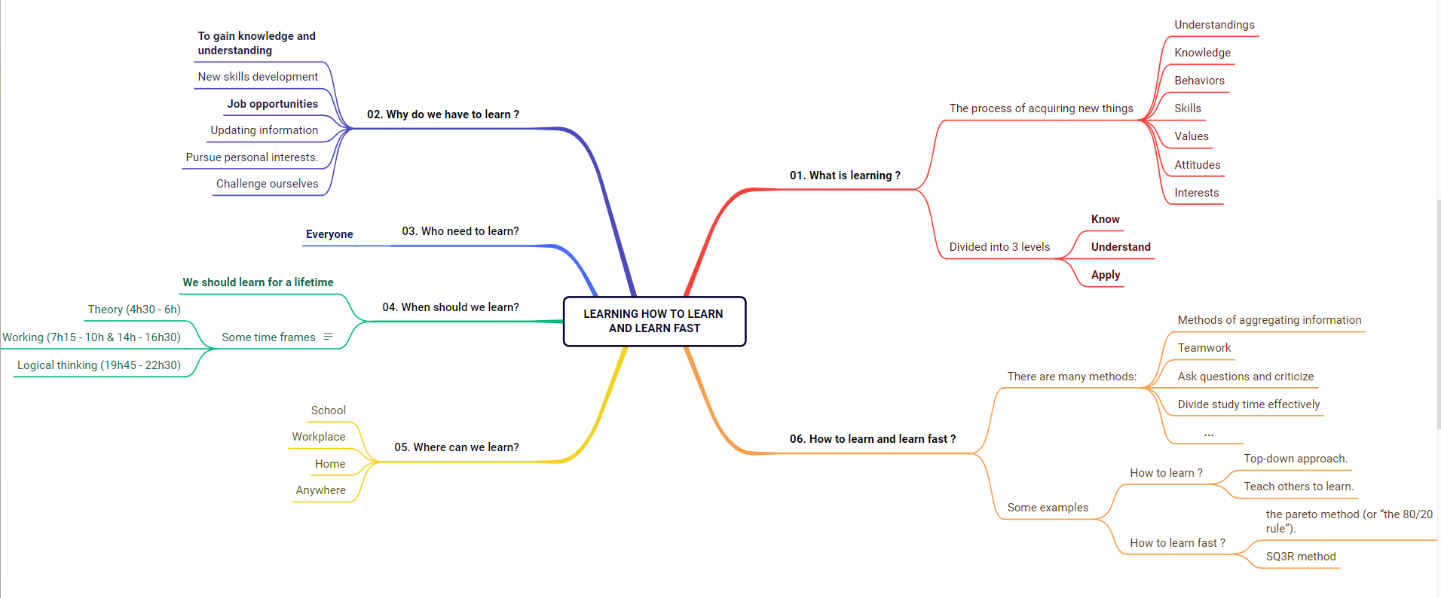
SUMMARY

Slide 24
THANKS!
Have a nice day!
Huynh Anh Tu
Phone: +84 929455098
Email: anhtu18042004@gmail.com

